Slide 1
Python overview

Slide 2
What is python?
Python is an interpreted, object-oriented, high-level, general-purpose programming language with integrated dynamic semantics primarily for web and app development.
Python is relatively simple, so it's easy to learn since it requires a unique syntax that focuses on readability. Developers can read and translate Python code much easier than other languages. In turn, this reduces the cost of program maintenance and development because it allows teams to work collaboratively without significant language and experience barriers.
Python is more productive than conventional languages, such as C and Java, for programming problems involving string manipulation and search in a dictionary, and determined that memory consumption was often "better than Java and not much worse than C or C++"

Slide 3
Popularity
Python is the third most popular language (behind Java, and C) and also it was selected Programming Language of the Year in 2007, 2010, and 2018.

Slide 4

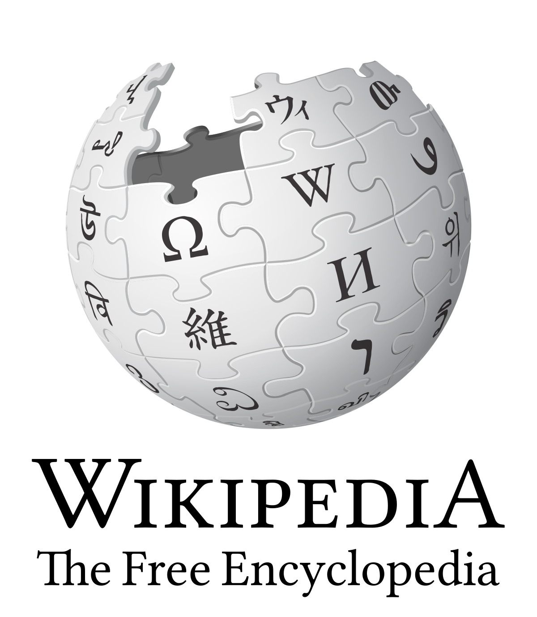


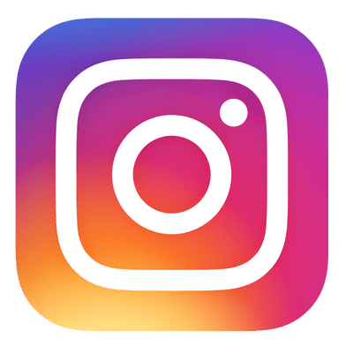
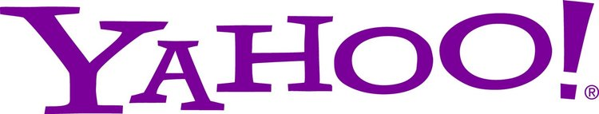


Who are using python?

Slide 5
References
https://en.wikipedia.org/wiki/Python_(programming_language)
https://www.pythonforbeginners.com -

